Slide 1
MOHAI COVID-19 Reopening Communications Campaign
Angela M Brown
Dec 13, 2020

Slide 2
Organization Mission
Problem
To collect and preserve “artifacts and stories of the Puget Sound region’s diverse history”
To engage with and inspire individuals and the community.
Due to the COVID-19 pandemic, MOHAI has been closed to the public since March 12, 2020.
MOHAI will open once again to visitors on March 1, 2021.
A communications campaign is necessary to inform the public when MOHAI will be reopening as well as what protective practices are in place and how they will impact the visitor experience.

Slide 3
SWOT Analysis
Strengths
Top 10 Seattle attraction, according to The Seattle Times.
Traveler’s Choice 2020 award winner and highly rated attraction on TripAdvisor.
Fun for all ages.
Scenic Lake Union waterfront location in historic building.
Opportunities
Increase awareness and traffic to MOHAI virtual events and experiences.
Motivate followers and public to become members.
People hesitant to visit can still provide financial support.
Weaknesses
Popular interactive exhibits are high touch and will remain closed to the public.
Funding challenges due to increased operating costs and reduced ticket sales.
Threats
Risk of infection to both visitors and staff.
Additional closure mandates.
Negative reputation impact if reopening is poorly implemented.

Slide 4
Campaign elements
Theme
Key messages
Cooperative and welcoming
Reopening to the public on March 1, 2021, with restrictions
Let’s keep MOHAI safe together
Online, reserved day and time ticket sales only
If you can’t visit, you can still show your support for MOHAI by donating or becoming a member
Objectives
To inform the target audiences when MOHAI will open and what restrictions will be imposed on museum visitors
Call to Action
Reserve Timed Ticket Online

Slide 5
Engagement Tactics
Channel | Target Audience
 | Museum Members | Museum Followers | General Public
Direct mail postcard | X
Press Release | X | X | X
Digital Banner Ads | X | X | X
Social Media | X | X
COVID-19 landing page | X

Slide 6
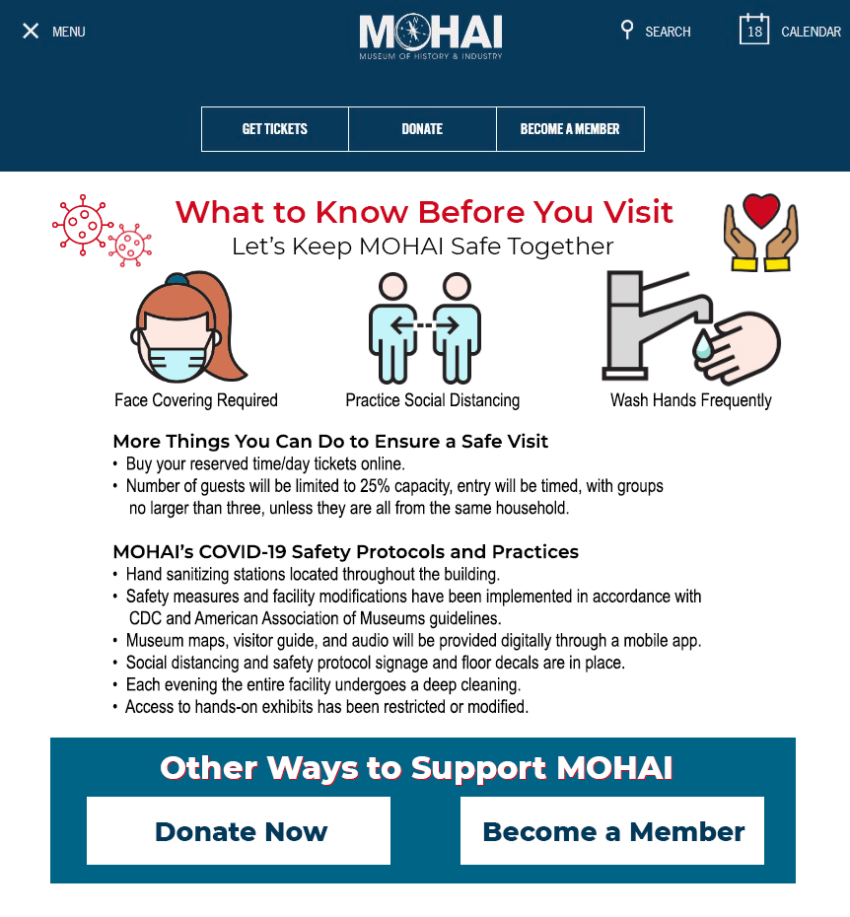
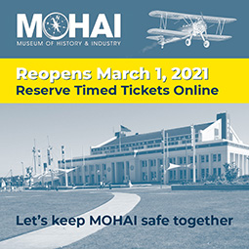
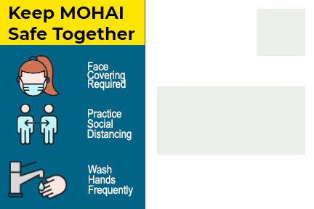
Creative Concepts
Postcard to Members
COVID-19 Landing Page
Banner Ads & Social Media

Slide 7
Campaign Timeline
PHASE 1
Feb 8
COVID-19 landing page and reserved ticketing page go live on official MOHAI website
Mar 1
Digital banner ads (Phase 2) publication begins in local digital news media
Mar 2 to Apr 11
Digital banner ads (Phase 2) publication continue in local digital news media
Direct mail postcards sent to museum membership list
Press release distributed to local radio stations, print and digital news publications, and TV stations
Digital banner ads (Phase 1) publication begins in local digital news media
Social media (Phase 1) postings begin and continue twice weekly until opening day
Social media (Phase 2) postings begin
Social media (Phase 2) postings continue twice weekly
Kickoff
PHASE 2
Opening
Day
Post
Opening

Slide 8
Success Metrics
Overall Success
Digital Channel Metrics
Tickets sold
Attendance
New memberships
Donations
COVID-19 Landing Page | “Buy Ticket” Webpage | Digital Banner Ads | Social Media
Page views Unique visitors Bounce Rate Referrals | Page views Unique visitors Bounce Rate Referrals Purchases | Impressions Clicks | Impressions Link clickthroughs Social media shares Social media comments Retweets Likes
Press Release Metrics
Pickups
Mentions
Postcard Metrics
Post-campaign survey results

Slide 9
sources
MOHAI – MOHAI’s Mission. (n.d.). Retrieved November 06, 2020, from https://mohai.org/about/#mission
Jackson, K. (2016, November 22). Seattle's Top 10 attractions. Retrieved November 11, 2020, from https://www.seattletimes.com/life/travel/seattlersquos-top-10-attractions/
Museum of History & Industry (Seattle) - 2020 All You Need to Know BEFORE You Go (with Photos). (n.d.). Retrieved November 10, 2020, from https://www.tripadvisor.com/Attraction_Review-g60878-d141518-Reviews-or5-Museum_of_History_Industry-Seattle_Washington.html
Images
Museum of History & Industry photo – Pixabay

